Slide 1

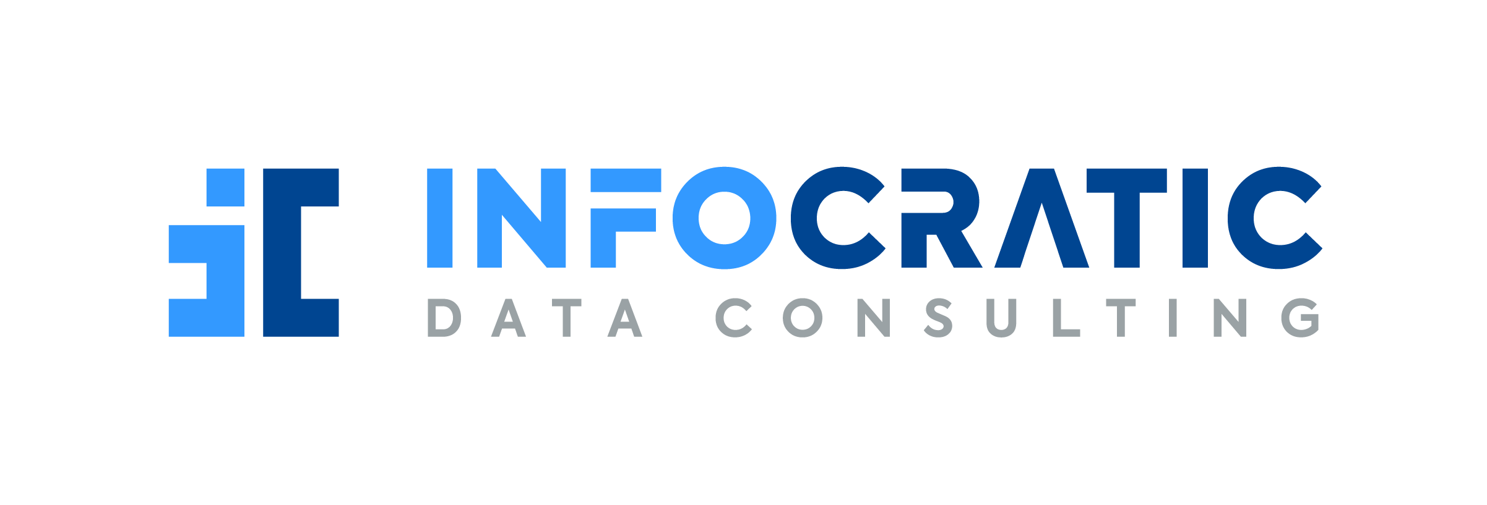
Why Data-centric organizations have an advantage in the digital economy
October 21, 2021
Ruben Sardaryan
Notes:
Intro / warm up questions / surveys
Are you guys excited to talk about data strategy?
Now, let me mention that I will be giving away a bonus at the end of the webinar. Something to help you boost your data strategy.
We will have a Q & A time after the slides, so please type your questions in the chat as you think of them – I will read and address all of them, starting from the top ones.
Feel free to take screenshots, but know that I’ll be sharing the deck.

Slide 2
In today’s talk
What is a data-centric organization?
Differences between data-centric and app-centric organizations
Why data-centric organizations have an advantage?
How to get there? Tips on becoming data-centric.

Slide 3

About
Helping organizations increase revenues and reduce costs using data & analytics
Data strategy advisor
CEO & Founder, Infocratic
Data strategist with 20+ years experience in data & IT leadership
Led data & analytics for 10 years at Questrade –growing it to become Canada’s top brokerage
Father, husband, musician, glider pilot
Ruben Sardaryan
Notes:
At infocratic we change how people and organizations think about data and help them become data-centric.
My name is Ruben and I’m a data strategist.
I have a technology background, and I’ve led data and analytics at Questrade – Canada’s largest brokerage firm - for the past 10 years.
In my career, I went from being a software developer, to a data & analytics leader, to now being a data strategist. There was a time when I was a person of algorithms and software, then I was a person building data warehouses and running analytics programs. Then I went into data management which made me look holistically at organization’s data lifecycles. Then at some point I had an epiphany, when I realized the immense value of a data-centric approach to transform businesses. Once you start seeing the world through the lens of data lifecycles, you can’t go back. That’s why now I run my own consultancy focusing on helping companies become data-centric.

Slide 4
What is a data-centric org?
Notes:
Poll – put your definitions in comments

Slide 5

What matters more – the wallet or the money inside ?
Notes:
Data Strategy is, well, strategy that applies to data in the organization.

Slide 6
What is a Data-Centric organization?
Data-centric organization has a single data model; and prioritizes managing data & information over managing systems & technology.
Notes:
Data Strategy is, well, strategy that applies to data in the organization.

Slide 7
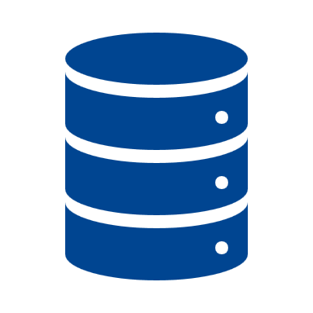
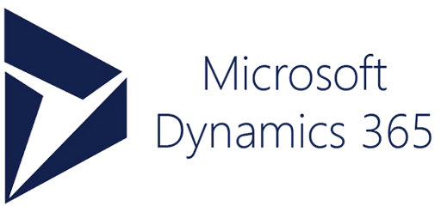


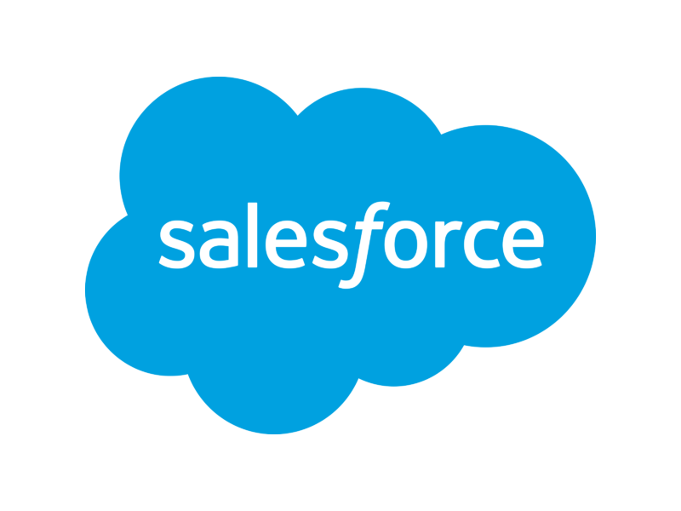

Data-centric vs. app-centric organizations
App-Centric
Data-Centric
App 1
App 1
App 2
App 2
Single data model
App 3
App 3
App 4
Power BI
App 4
Power BI
Notes:
Data is the lifeblood that connects all of your organization.
99% of organizations have an app-centric or system-centric mindset. They buy or build specific solutions to perform specific functions. Now, the problem with that approach is that it has a lot of waste.
It doesn’t matter whether these systems are built, bought or implemented as a service. It doesn’t matter what technology is employed. Each additional application creates another data silo, adds complexity and costs. Costs that can be 10s to 100s of times than those of data-centric orgs. The more there are systems, the more there is need for integration. It is estimated that 40-70% of IT budgets are spent on integration one way or another.
Data-centric organizations are built around unified data models and data lifecycles, not systems. They emphasize the reuse of data by as many apps and systems as possible. In a data-centric org, apps become experiences, processes, interfaces, etc.

Slide 8
Why data-centric organizations have an advantage?
Notes:
There are a number of reasons, why data strategy is becoming a top priority.
As we will see later in this talk – not only companies - countries are starting to adopt data strategies.

Slide 9

In 2021 every business is a data business
Notes:
Everything is digital, and digital runs on data. Every business is a data business these days. Data is the lifeblood of an enterprise participating in the modern digital economy.
There’s a quote from a VP of Data of Textron, which is a huge manufacturing company – 50 thousand people. they own Cessna, Bell helicopter, etc.
So their VP of data said “70% of our staff never touch an aircraft, but all of our employees touch data every day. We are a data company”.

Slide 10

Being app-centric implies a lot of extra costs
Infrastructure costs
Integration costs
Complexity costs
Agility costs
Data quality & trust costs
All of this is the result of
app-centric approach
Notes:
Launch poll – does your org have a data strategy?

Slide 11
The digital economy will embrace only those that adopt a data-centric mindset
Our mission is to help you excel at being data-centric.
Notes:
Infocratic’s mission is to help you excel at being data-centric.

Slide 12
How to become a data-centric organization?
Notes:
This part will be interesting for technology / data leaders. There will be some more tech speak here, that might sound a bit alien, if you are not into data or tech.

Slide 13
No single strategy as every organization is different
Maturity & awareness
Size & structure of the organization
Composition & complexity of the technology landscape
Existing digital / data strategy
Available competences & skills
Funding & resources
Notes:
Launch poll – does your org have a data strategy?

Slide 14

1. Full understanding and buy-in at the top
Notes:
Launch poll – does your org have a data strategy?

Slide 15
2. Awareness of the foundational data lifecycles and their main principles is crucial
Metadata
Master / Reference
data
Event / Transactional
data
Historical / Analytical
data
Temporary data
Each of these foundational data classes has core principles that apply regardless of where the data is contained.
Notes:
These are foundational data classes. Why I say foundational, because all structured data, and most of unstructured data in the organization can be classified as one of these.
Each of these classes has principles that apply to them, which hold true regardless of the technology. When this principles are violated, bad things happen. Companies start losing money.

Slide 16

3. Focus on company CULTURE & communicate, communicate, communicate!
And once you’re sick of it
– communicate even more!
Notes:
These are foundational data classes. Why I say foundational, because all structured data, and most of unstructured data in the organization can be classified as one of these.
Each of these classes has principles that apply to them, which hold true regardless of the technology. When this principles are violated, bad things happen. Companies start losing money.

Slide 17

4. Take things step-by-step & be systematic
Notes:
These are foundational data classes. Why I say foundational, because all structured data, and most of unstructured data in the organization can be classified as one of these.
Each of these classes has principles that apply to them, which hold true regardless of the technology. When this principles are violated, bad things happen. Companies start losing money.

Slide 18

5. Get good at data modeling graphs – relational - analytical
Notes:
These are foundational data classes. Why I say foundational, because all structured data, and most of unstructured data in the organization can be classified as one of these.
Each of these classes has principles that apply to them, which hold true regardless of the technology. When this principles are violated, bad things happen. Companies start losing money.

Slide 19
What an organization needs to become data-centric (summary)
1. Executive team understanding & buy-in
2. Awareness of foundational data lifecycles and their principles
3. A lot of communication and culture building
4. Systematic approach (+ start small)
5. Good data modeling is key
Notes:
These are foundational data classes. Why I say foundational, because all structured data, and most of unstructured data in the organization can be classified as one of these.
Each of these classes has principles that apply to them, which hold true regardless of the technology. When this principles are violated, bad things happen. Companies start losing money.

Slide 20
Data-centric vs. app-centric organization traits
Data-centric | App-centric
Data is shared | Data is hoarded
Technology landscape is elegant and simple | Technology landscape is vast and complex
Company focuses on data & information; technology is a tool | Company focuses on technology; information & data is an afterthought
Little to no data silos | Many data silos
High level of trust in data | Low level of trust in data
High levels of data literacy on average | Low levels of data literacy on average
High degree of agility & innovation | Low degree of agility & innovation
Notes:
These are foundational data classes. Why I say foundational, because all structured data, and most of unstructured data in the organization can be classified as one of these.
Each of these classes has principles that apply to them, which hold true regardless of the technology. When this principles are violated, bad things happen. Companies start losing money.

Slide 21
Questions?
Notes:
Before we talk about the bonus, I would like to give you an overview of how we work, for the bonus to make sense.

Slide 22
3 Main Takeaways
1. Adopt a data-centric mindset (as opposed to app-centric)
2. Approach organizational data lifecycles strategically
3. Focus on culture, awareness & skills, not on technology
Notes:
So, we spoke earlier about what a DS IS and why it is important.
I want to leave you with 3 main takeaways from today’s talk:
#1 - in today’s digital economy, your business is going to thrive or take a dive, based on whether you adopt a data-centric approach. If you continue with the outdated system- or app-centric approach, eventually you are going to be outpaced by competition that doesn’t have those drawbacks, and who also, as a data-centric org, enjoy a whole lot of capabilities that you don’t have and can’t really afford.
#2 – start thinking in data lifecycle – that is a key mindset shift and a steppingstone to data-centricity
#3 – focus on culture, awareness & data strategy, not on technology.

Slide 23
3 questions to ask yourself
1. What will your organization look like in 3-5 years if you adopt and execute a data-centric approach?
2. What will it look like in 3-5 years if you don’t?
3. What’s at stake? (try to quantify the impact for your org)
Notes:
So, we spoke earlier about what a DS IS and why it is important.
I want to leave you with 3 main takeaways from today’s talk:
#1 - in today’s digital economy, your business is going to thrive or take a dive, based on whether you adopt a data-centric approach. If you continue with the outdated system- or app-centric approach, eventually you are going to be outpaced by competition that doesn’t have those drawbacks, and who also, as a data-centric org, enjoy a whole lot of capabilities that you don’t have and can’t really afford.
#2 – start thinking in data lifecycle – that is a key mindset shift and a steppingstone to data-centricity
#3 – focus on culture, awareness & data strategy, not on technology.

Slide 24
Our mission is to help you excel at being data-centric
Notes:
To empower you with a data-centric mindset and knowledge. This is needed to make you invincible in today’s world, where technology changes all the time.

Slide 25

Thank you!
More webinars on infocratic.io
How to stay connected:
Follow Ruben Sardaryan & Infocratic on
Subscribe to the email newsletter here or at infocratic.io
contact@infocratic.io
Notes:
Before we talk about the bonus, I would like to give you an overview of how we work, for the bonus to make sense.

